Slide 1
08 | Rewind
James Chambers | @CanadianJames
Simon Timms | @stimms

Slide 2
Module Overview
Please leave this area blank to allow for picture in picture recording
What we have done

Slide 3
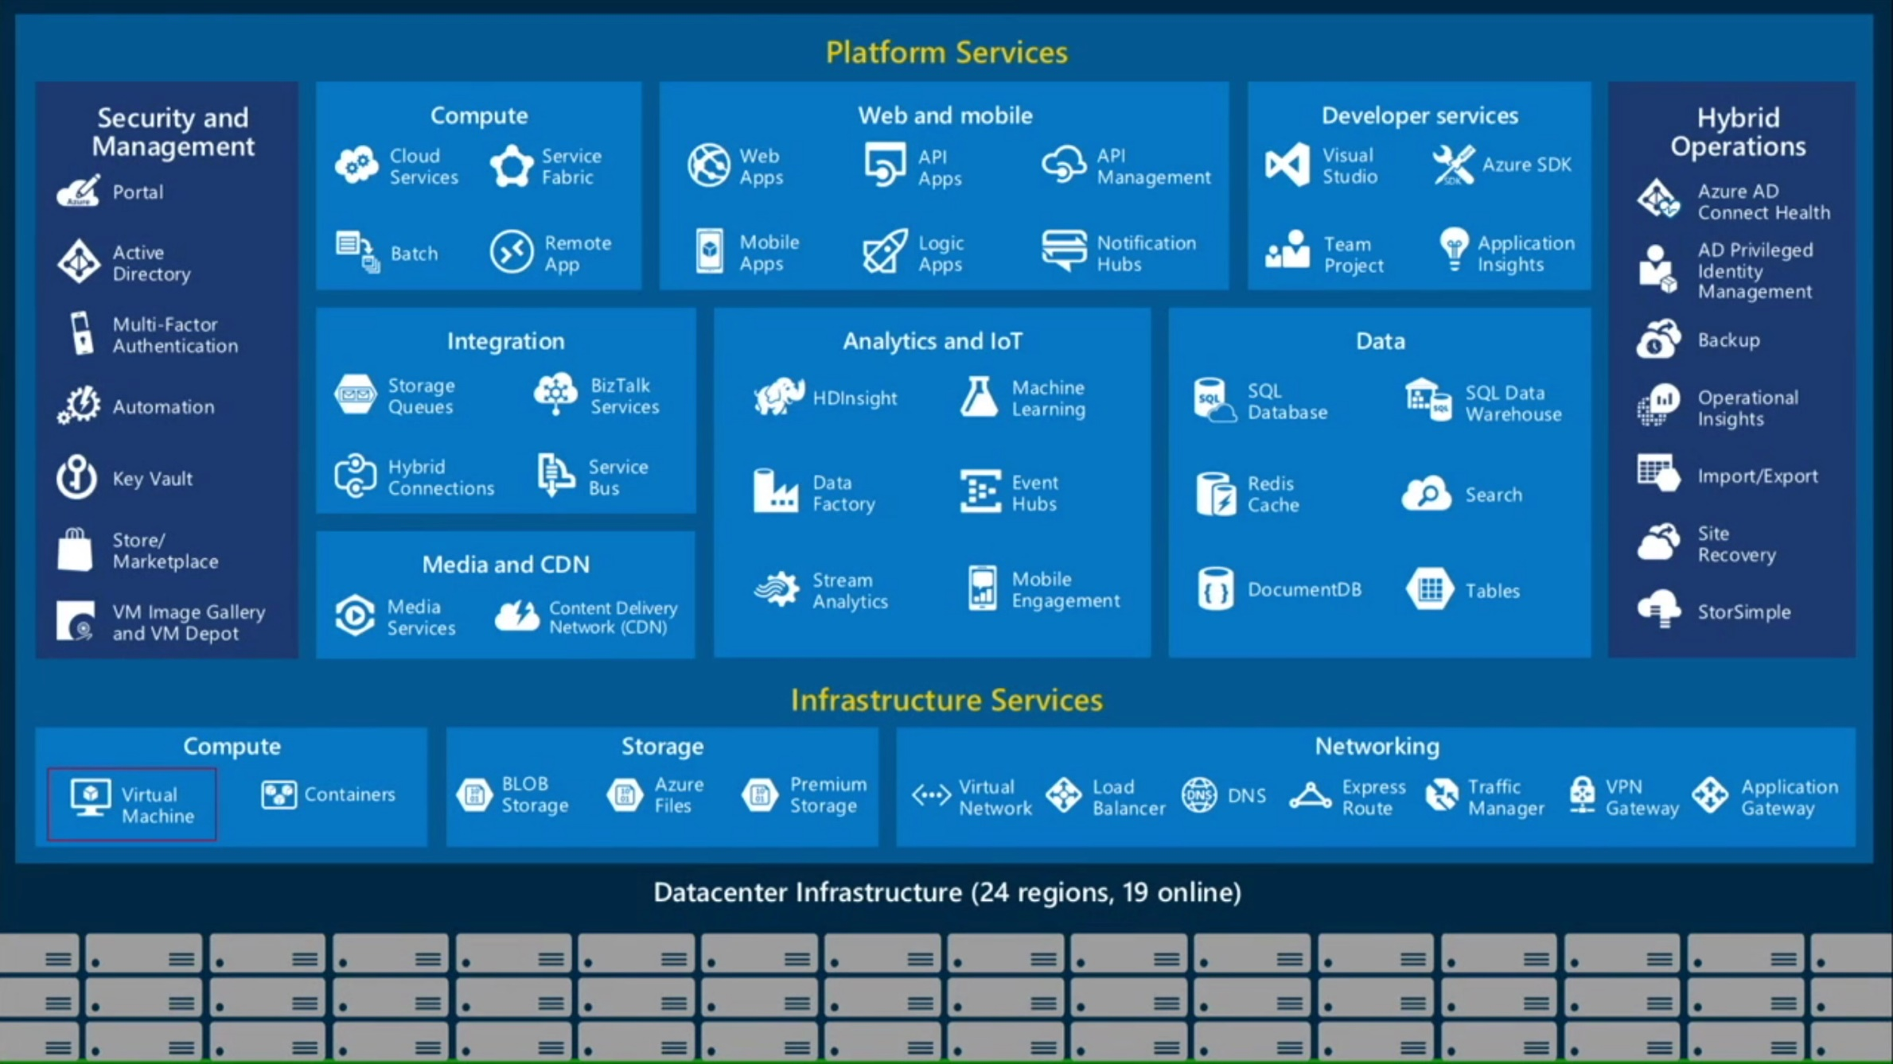
Bits of Azure
Please leave this area blank to allow for picture in picture recording

Slide 4
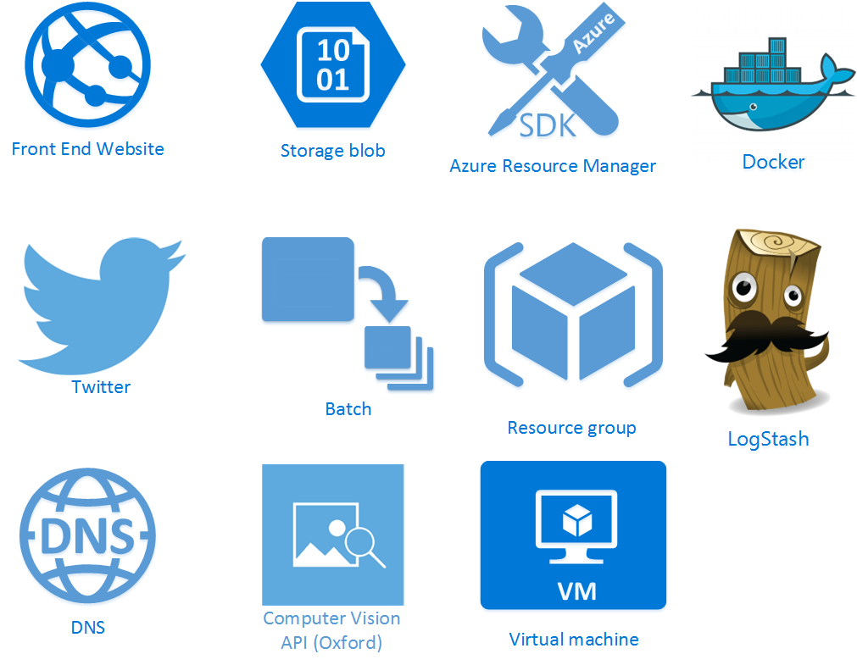
Please leave this area blank to allow for picture in picture recording

Slide 5
Questions? Drop us a line
Please leave this area blank to allow for picture in picture recording
@stimms
@canadianjames

